Slide 1
Good old wordcount
http://salsahpc.indiana.edu/ScienceCloud/pig_word_count_tutorial.htm

Slide 2
In /usr/local/hadoop
wordcount.pig (the script)
A = load './input.txt';
B = foreach A generate flatten(TOKENIZE((chararray)$0)) as word;
C = group B by word;
D = foreach C generate COUNT(B), group;
store D into './wordcount';/*
input.txt (input doc that we will count words in)

Slide 3
Some more examples
Go to these sites to get these 2 books:
http://www.gutenberg.org/ebooks/1112
http://www.gutenberg.org/ebooks/10
(I have them on Canvas for you)

Slide 4
Prepare Data For Joins
Run a pig job to prepare the Shakespare and King James Bible data for the following examples:
A = LOAD ‘KingJamesBible.txt';
B = FOREACH A GENERATE FLATTEN(TOKENIZE((chararray)$0)) AS word;
C = FILTER B BY word MATCHES '\\w+';
D = GROUP C BY word;
E = FOREACH D GENERATE COUNT(C), group;
STORE E INTO 'bible_freq';
Do same thing for RomeoAndJuliet.txt, store into romeo_freq

Slide 5
Join
We can use join to find words that are in both the King James version of the Bible and Shakespeare’s collected works
bard = LOAD ‘romeo_freq’ AS (freq, word);
kjv = LOAD ‘bible_freq’ AS (freq, word);
inboth = JOIN bard BY word, kjv BY word;
DUMP inboth
Results:
2 Abide 1 Abide
2 Abraham 111 Abraham
3 …

Slide 6
Another example, using a public database of cities in the world
https://chimpler.wordpress.com/2013/02/04/playing-with-hadoop-pig/

Slide 7
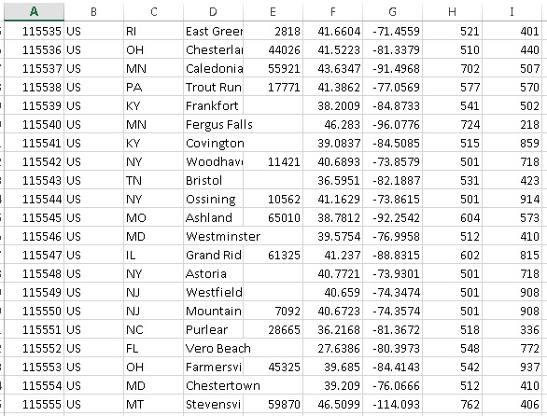
Go out and grab some public data
locId, country, region, city, postalCode, latitude, longitude, metroCode, areaCode

Slide 8
/* start by loading the CSV file and display it: */
/*The first line maps the different columns in the CSV to fields which are by default chararray (e.g., city:chararray).*/
data = LOAD 'location.csv' USING PigStorage(',')
AS (locId, country, region, city, postalCode, latitude, longitude, metroCode, areaCode);
/* get rid of info don’t need and only keep city, region and country: */
cities = FOREACH data GENERATE city, region, country;
/* only keep US cities where the city name is set: */
usCities = FILTER cities BY country == '"US"' AND city != '""';
/* Group by city */
cityGroups = GROUP usCities BY city;
/** In the CSV file, the same city can appear many times in a state, so we first
* need to make sure to remove duplicate states using DISTINCT.
* Note that we can access the cityGroups fields 'group' the key used for grouping
* and 'usCities' as the value of the group.*/
numStatesByCities = FOREACH cityGroups {
states = DISTINCT usCities.region;
GENERATE FLATTEN(group) AS city, COUNT(states) as numStates;
};
/* Order cities by number of occurrences in states */
sortedCitiesByNumStates = ORDER numStatesByCities BY numStates DESC;
/* Only keep the first 10 cities */
result = LIMIT sortedCitiesByNumStates 10;
store result into './citiesdata';

